Slide 1
Congestion Measures for Organized Electricity Markets in the U.S.
Emily Fisher
Lawrence Berkeley National Lab
Center for Climate and Energy Decision Making
Carnegie Mellon University
February 10, 2014

Slide 2
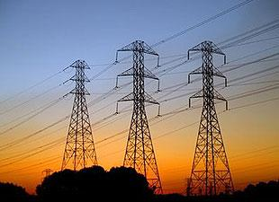

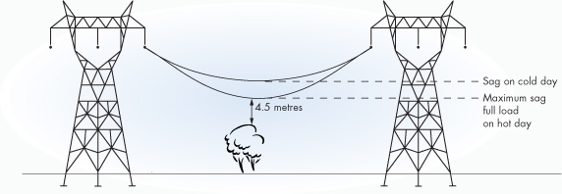

Electricity Transmission
Constraints and Congestion

Slide 3
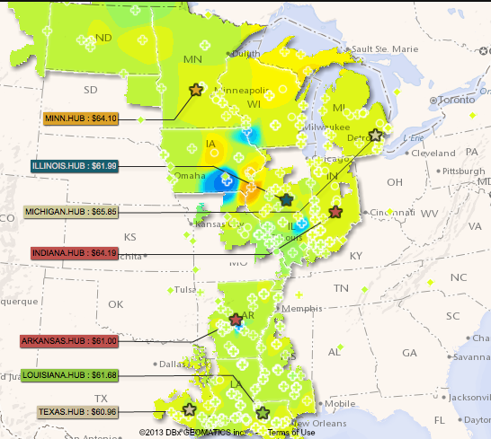
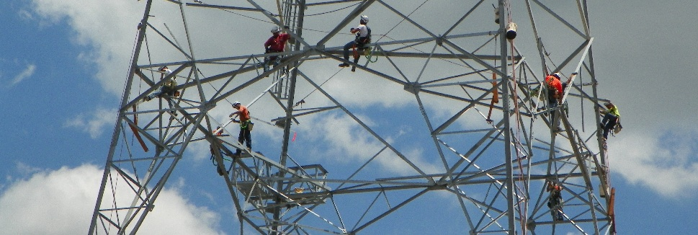
Why do we want to measure congestion?
Identify how much and where congestion exists, and how this changes over time can INFORM…
  Decisions about whether/how to relieve it
  Assessments of effectiveness of actions or policies
http://www.neiengineering.com/
MISO website

Slide 4
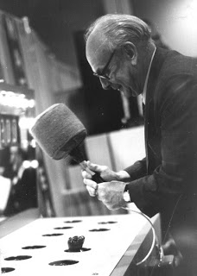
What these congestion measures CANNOT tell us
What to do (if anything) about congestion
How much money would be saved in the market if the existing congestion were removed

Slide 5

This talk
  How congestion in organized electricity markets in the U.S. (RTOs/ISOs) is measured and reported publicly
  What are underlying factors?
  Are measures consistent and comparable?

Slide 6
Prices and congestion management in organized markets
$20/MW
$30/MW
limit = 100
Dispatch | Quantity | Price
Gen A | 100 MW | $20/MW
Gen B | 50 MW | $30/MW
Load B | 150 MW | $30/MW
A
B
Load 150 MW
Locational Marginal Price
Min Σ [gen_offer] x [gen_output]
s.t. Σ [gen_output] + Σ [load] + Σ [trans_flow] ∀ buses (λ)
[trans_flow] ≤ [trans_MAX_flow] ∀ line (μ)
…
Shadow Price of Line

Slide 7
Congestion cost and congestion value
$20/MW
$30/MW
A
limit = 100
B
Load 150 MW
Congestion cost - accounting measure
Congestion value - economic measure
Load B | 150 MW x $30/MW | $4,500
Gen A | 100 MW x $20/MW | -$2,000
Gen B | 50 MW x $30/MW | -$1,500
Cong. Cost |  | $1,000
$10/MW x 100 MW = $1,000
$3,500 +$20 - $30 = $3,490
Shadow price x Flow

Slide 8
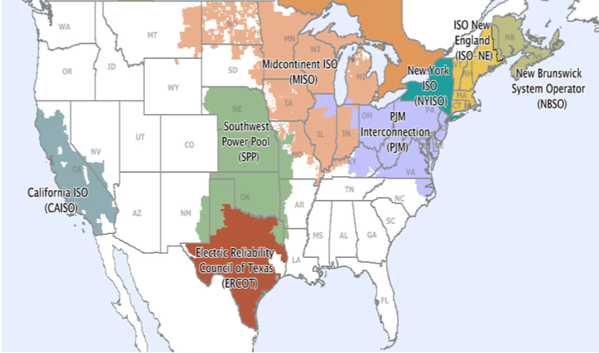
ISOs and RTOs in the US
Updated June 21, 2013
Source: http://www.ferc.gov/market-oversight/mkt-electric/overview.asp

Slide 9
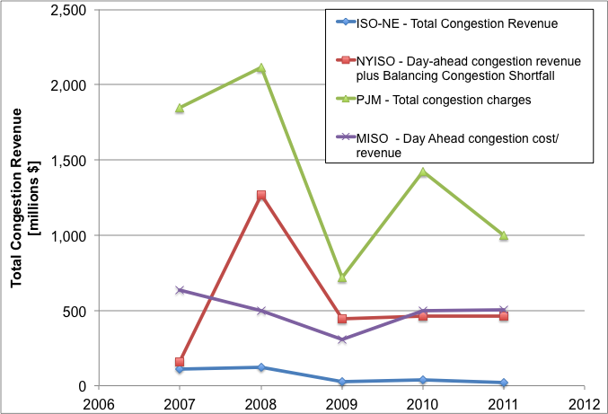
2011
Peak Load
158 GW
104 GW
34 GW
28 GW
Source: Annual State of Market reports

Slide 10
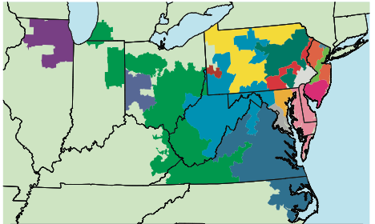
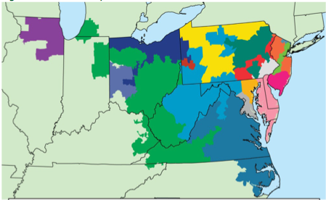
2007
2011

Slide 11
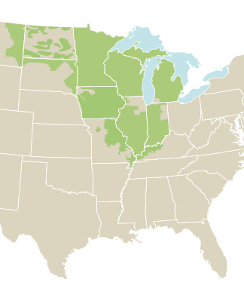
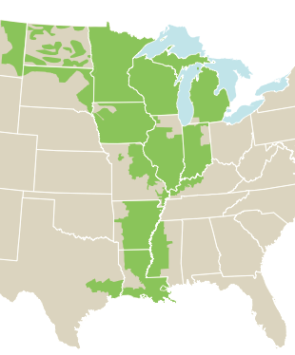
12/18/13
12/19/13

Slide 12
Publicly-reported congestion measures
 | ISO-NE | NYISO | PJM | MISO | SPP | CAISO
Total System Congestion Cost | X | X | X | X
Total System Congestion Value |  |  |  | X
Congestion on specific interface/flowgate:
Frequency |  | X (until ‘10) |  |  | X | X
Charges |  |  |  |  |  | X
Value |  | X (until ‘10) |  |  | X | X
Price impact |  |  |  |  |  | X
Ratio congestion cost to load (reports in 2010 and 2011) | X | X | X | X | X | X
Other |  | X |  |  | X

Slide 13
Drivers of congestion measured by congestion cost/value
Macro/external effects
Market design effects
Deviations from pricing theory
(Working Framework!)

Slide 14
Market-specific factors
Market rules and congestion management
  Settlement periods
  Use of TLRs
  Change in market footprint or rules
How much flow pays congestion prices
  Internal bilateral transactions
  Grandfathered rights
  Unscheduled loop flow
  etc.
How congestion prices are calculated
  Zonal vs. nodal prices
  Use of reference bus
  Use of constraint shadow price limit

Slide 15
Example 1 – Market rules and congestion management: TLRs
NYISO
ISO-NE
Manages some congestion with TLRs
Remaining congestion is managed through LMPs and economic re-dispatch
Congestion cost calculated using congestion price and day-ahead dispatch
Does not use TLRs
Congestion is managed through LMPs and economic re-dispatch
Congestion cost calculated using congestion price and day-ahead dispatch
Would these values be higher without use of TLRs?
Annual Congestion Cost per Load Served [$/MWh] (reported to FERC)
 | 2007 | 2008 | 2009 | 2010
NYISO | 4.90 | 8.20 | 3.00 | 3.80
ISO-NE | 0.90 | 0.80 | 0.20 | 0.30

Slide 16
Example 2 – Flows: agreements between markets about allowable flow
MISO
Loop flow from PJM over certain flowgates is not charged congestion
Total congestion cost is calculated as all congestion payments made; congestion value calculated as flow times shadow price
MISO | 2008 | 2009 | 2010
Annual Day Ahead Congestion Cost [$Million] | 500 | 305 | 498
Annual Real Time Congestion Value [$Million] | 940 | 860 | 1,030
Would these values be more similar if all PJM usage were charged congestion price?

Slide 17
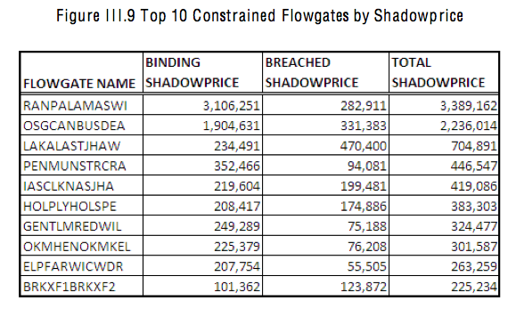
Example 3 – Prices: use of limit relaxation
SPP
Uses a violation relaxation limit (VRL) to allow small breaches of transmission limits in exchange for reducing cost of a feasible dispatch
Results in shadow prices that are different from what would exist otherwise
Congestion value calculated as flow times constraint shadow price
Source: SPP 2011 State of the Market
Would this list be different if VRL was not used, or if price for breaching limit were different?

Slide 18
Summary
Measuring congestion is important to plan, build and operate the electricity network efficiently, but it is difficult to measure (and not the whole story)
Organized markets in the US have different publicly-available measures of congestion
Even measures that appear to be the same can be incomparable because of market-specific factors
  rules that define congestion management, pricing and flow that pays for congestion
(And then there are non-organized-market areas…)

Slide 19



Recommendations
Need collaboration with ISOs/RTOs/market experts
More transparency in how existing measures are being calculated
Explore creation or standardization of consistent and straightforward measures

Slide 20
Questions?
Emily Fisher
esfisher@lbl.gov
http://emp.lbl.gov/research-areas/transmission

