Slide 1


TRACKING TOXIC AIR POLLUTANTS from emissions to impacts
Carnegie Mellon University
Center for Climate and Energy Decision-Making Seminar
2 December 2013
NOELLE E. SELIN
selin@mit.edu
@noelleselin
http://mit.edu/selin

Slide 2
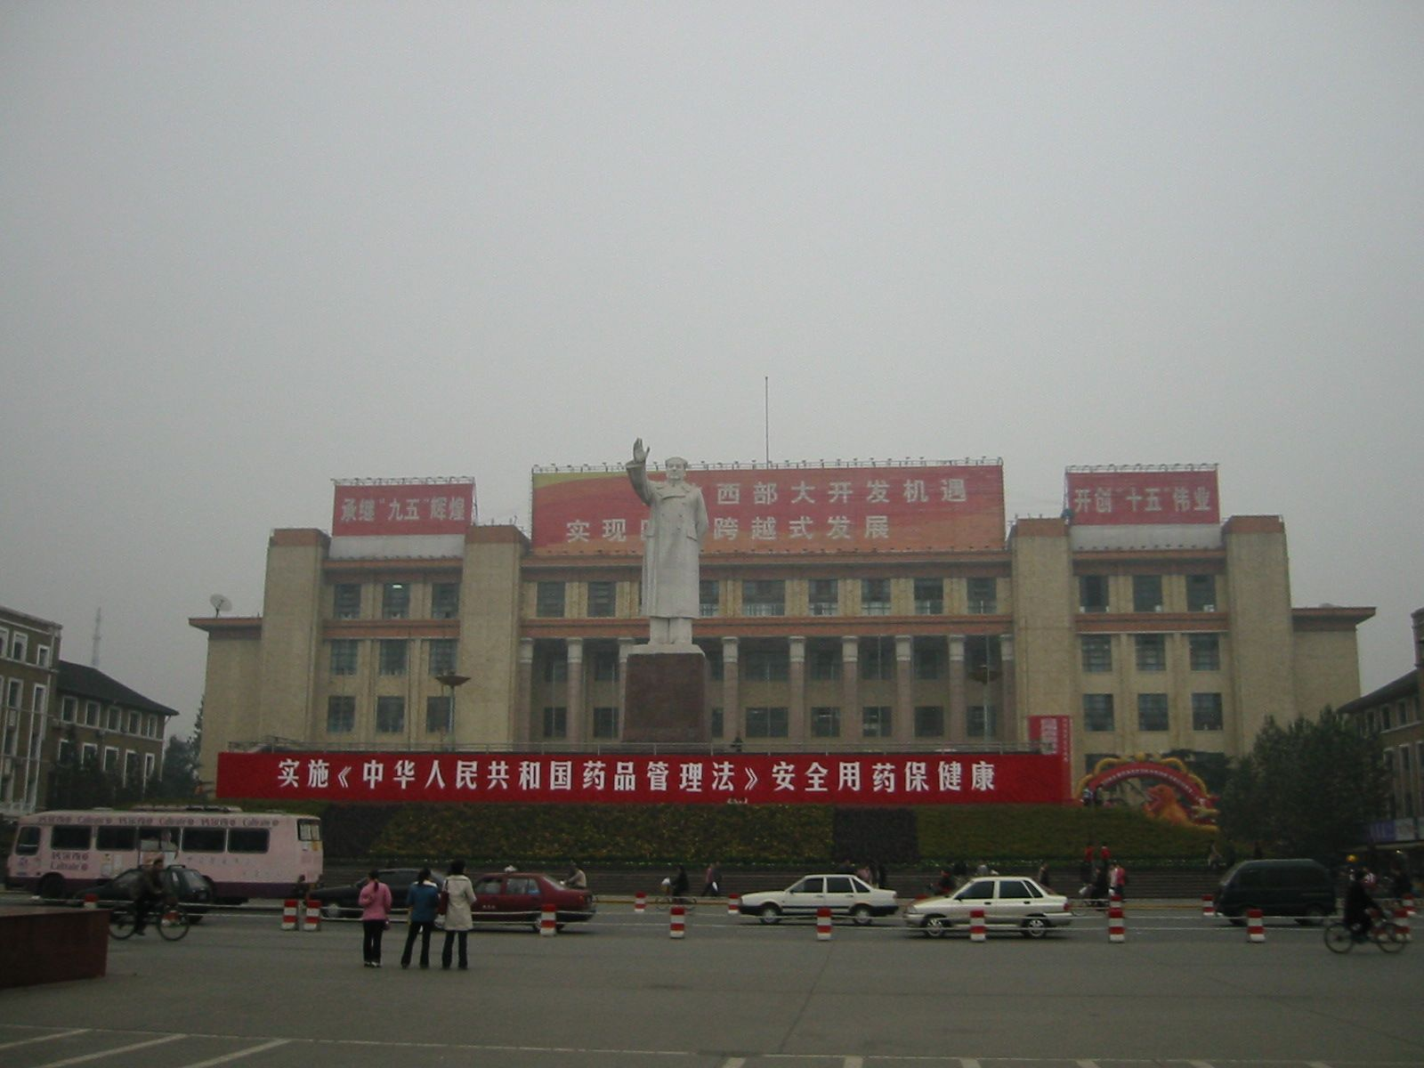
Particles are a leading cause of global disease

Slide 3
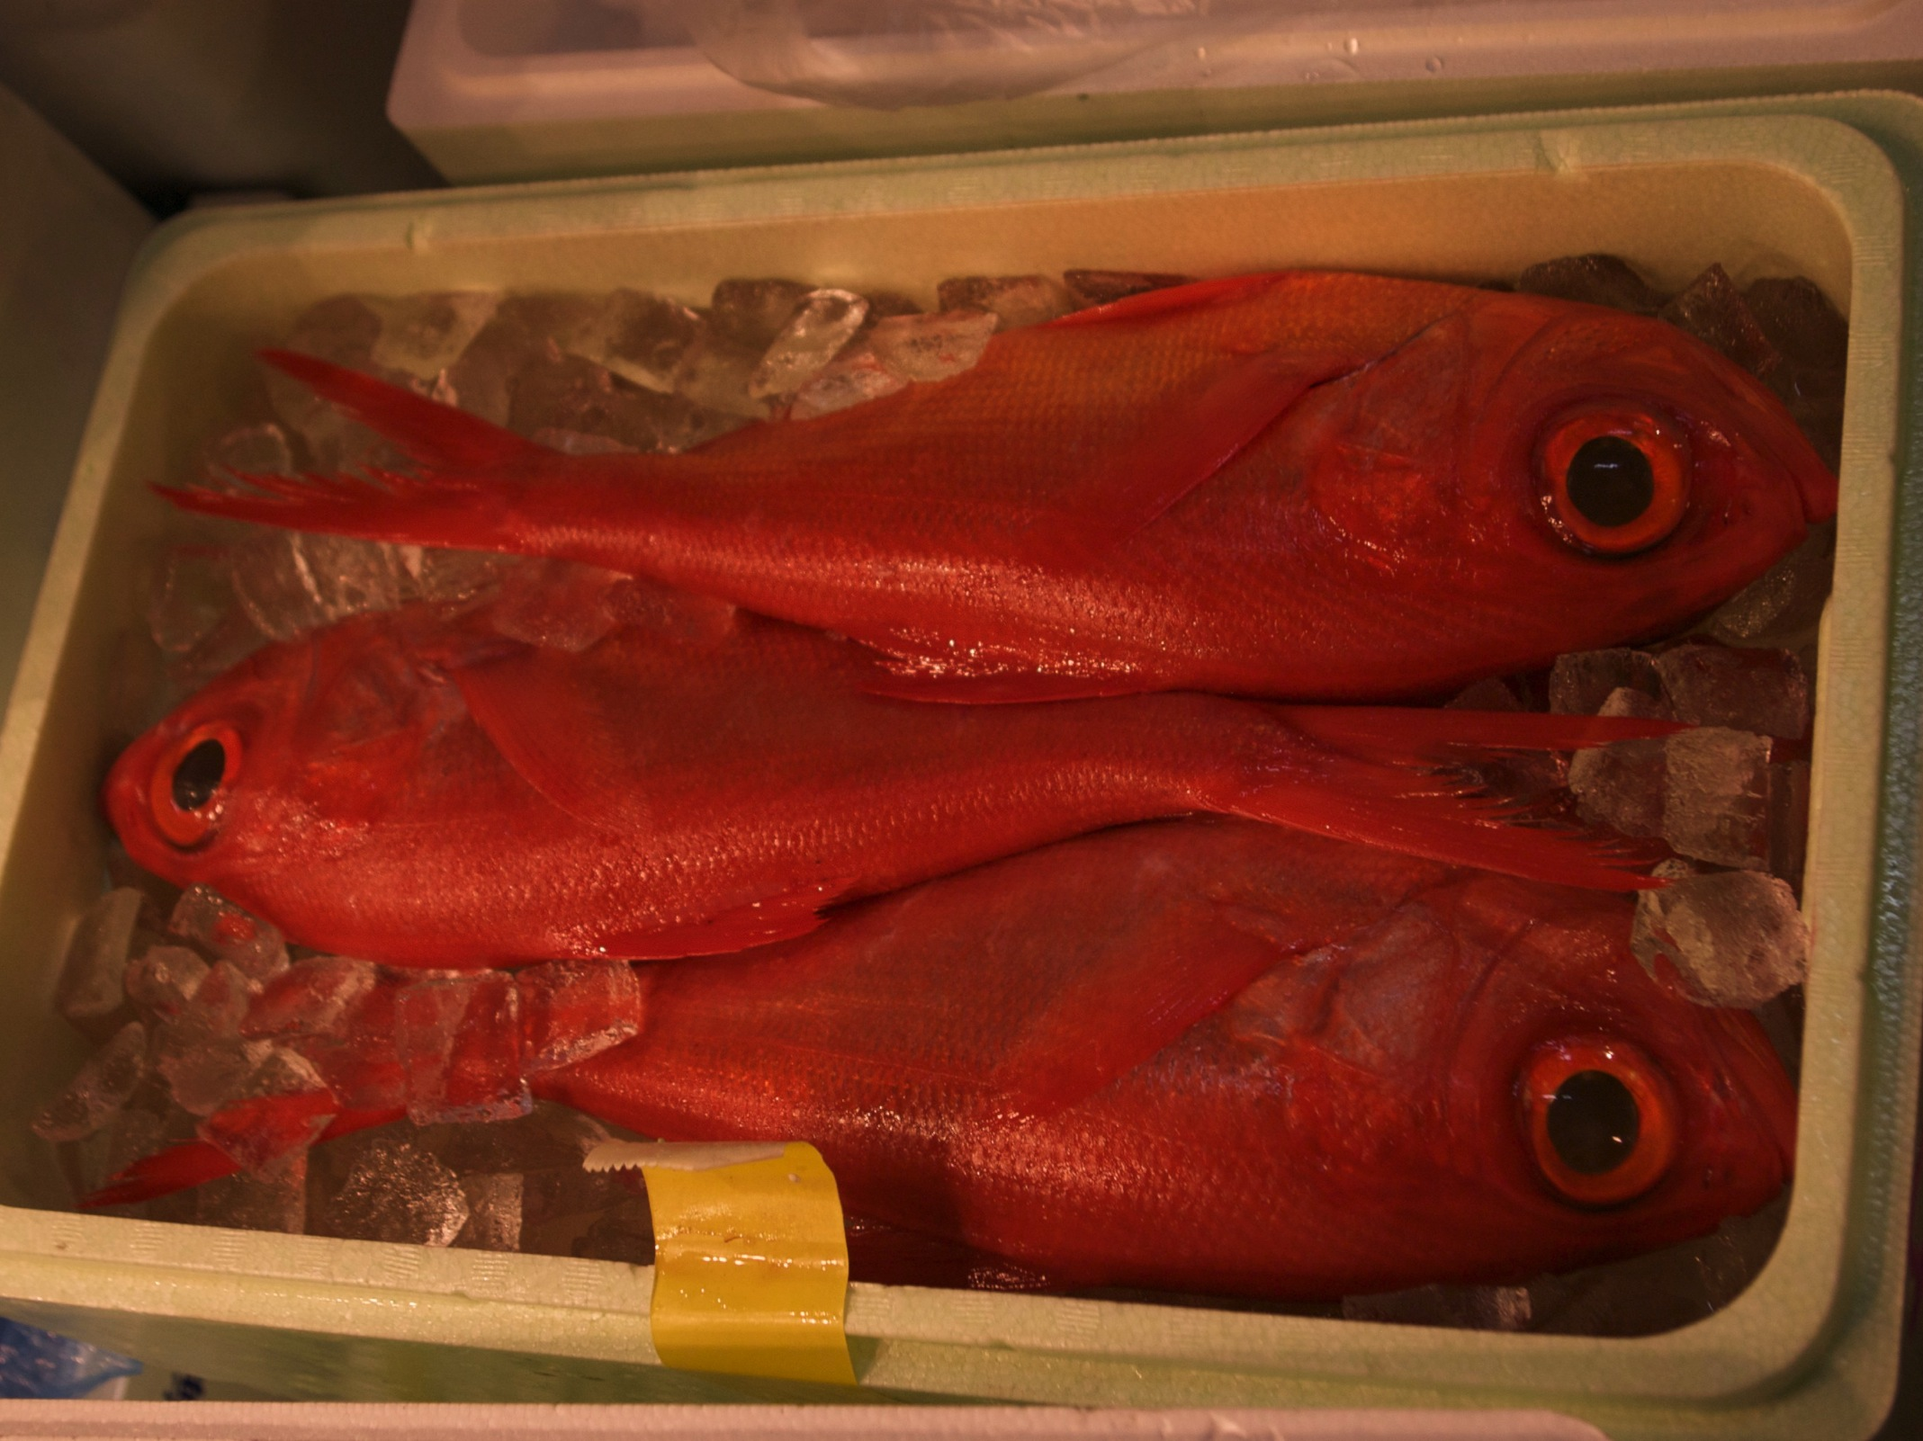
Mercury harms 600,000 U.S. babies each year

Slide 4

Toxic air is everywhere

Slide 5
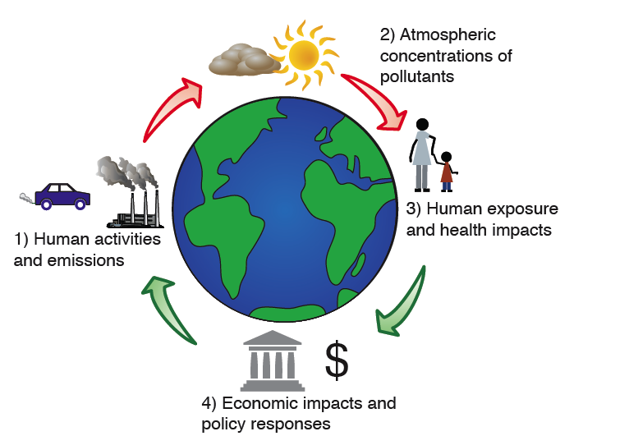

Slide 6
Future emissions implications: Selin, ET&C 2013; Friedman et al. ES&T in press
Transport of Hg/
POPs: Selin et al. JGR 2007, GBC 2008; Selin & Jacob AE 2008, Friedman & Selin ES&T 2012
Assessment of economic impacts of pollution: Selin et al. ERL 2009; Matus et al. GEC 2012; Nam et al. Energy Policy 2010
Toxics policy: Selin, JEM 2011; Selin & Selin, RECIEL 2006; Selin, 2005, 2006 (MIT Press)

Slide 7
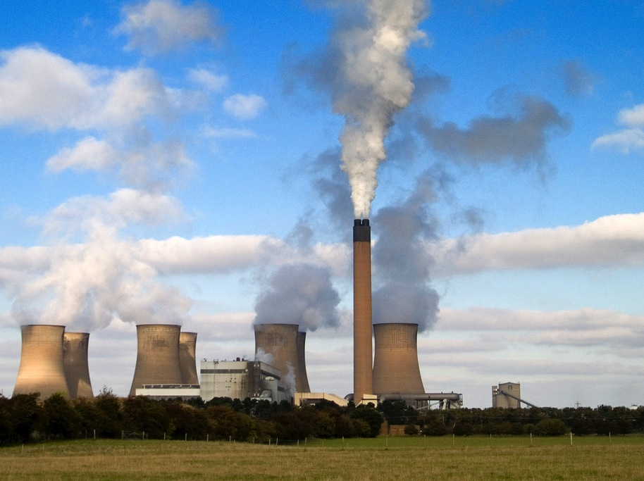
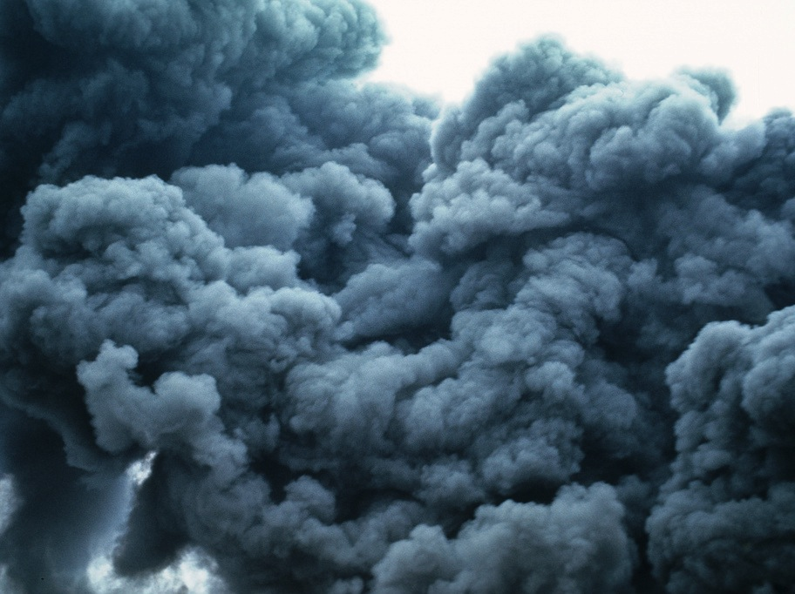
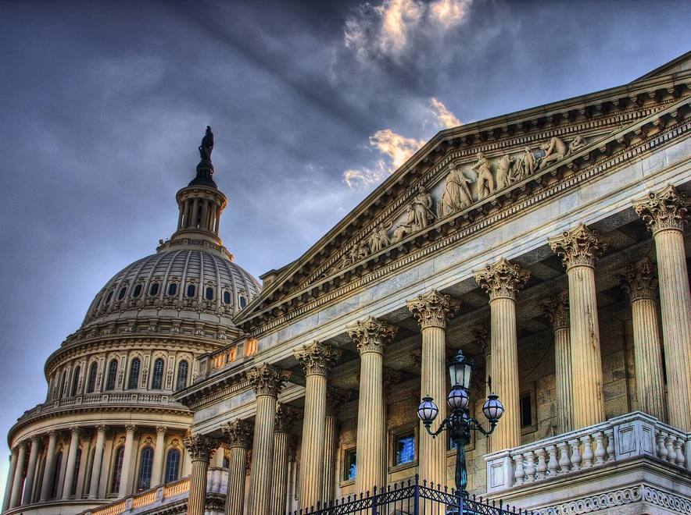
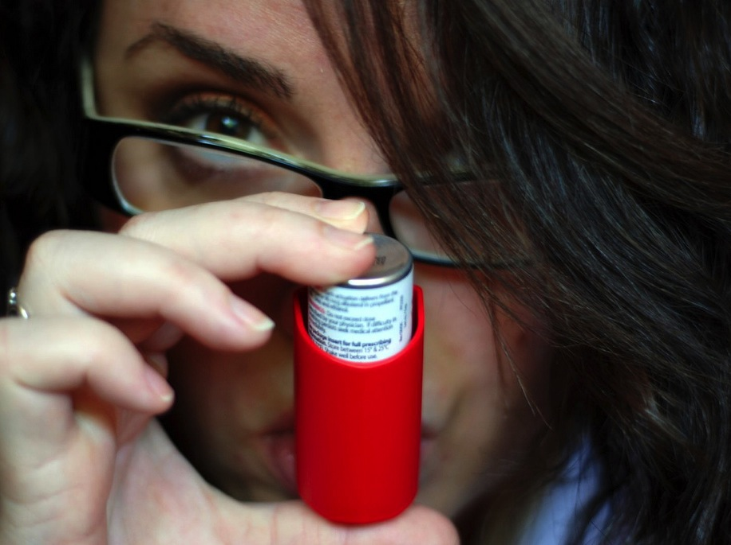
Flickr/JonPinder cc
Flickr/WIDNR cc
To manage air pollution effectively, we need to understand the whole system
Flickr/vgm8383 cc
Flickr/meg’s my name cc

Slide 8


Two examples of tracking emissions to impacts to inform policy
1
Air pollution impacts of US climate policy
US benefits from global mercury treaty
Policies-to-impacts sensitivity analysis approach

Slide 9
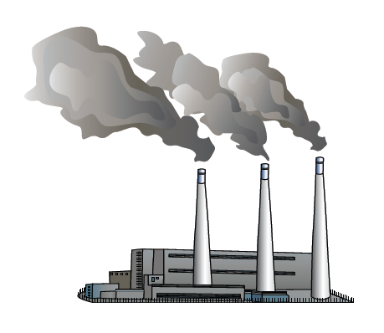
Air quality impacts of US climate policy
T. M. Thompson, S. Rausch, R. K. Saari, and N.E. Selin, “Air Quality Co-Benefits of US Carbon Policies: A Systems Approach to Evaluating Policy Outcomes and Uncertainties,” under review

Slide 10

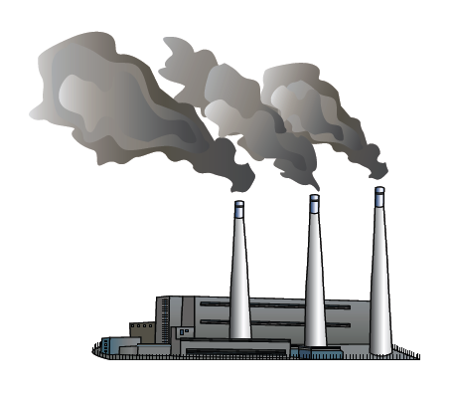

Carbon Policies
reduce CO₂ by 10% from 2006 to 2030
Cap and Trade
Clean Energy
Transportation

Slide 11
Carbon policies target different sources.
WHAT DOES THAT MEAN FOR OZONE AND PM_{2.5}?

Slide 12
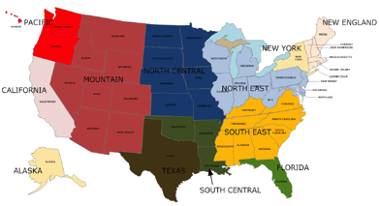
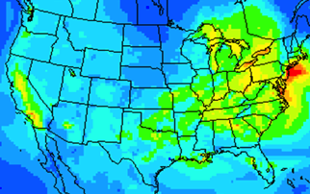
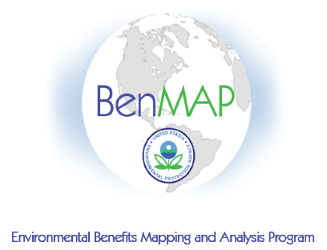
Integrated assessment
modeling economy, atmosphere, and health
USREP
CAMx
BenMAP
Policies alter economy and emissions
Emissions, chemistry and transport
Exposure leads to health impacts and costs
Notes:
Mention two “methods” papers to figure out what resolution to run CAMx at (Thompson and Selin ACP 2012, Thompson et al. ACPD 2013)

Slide 13
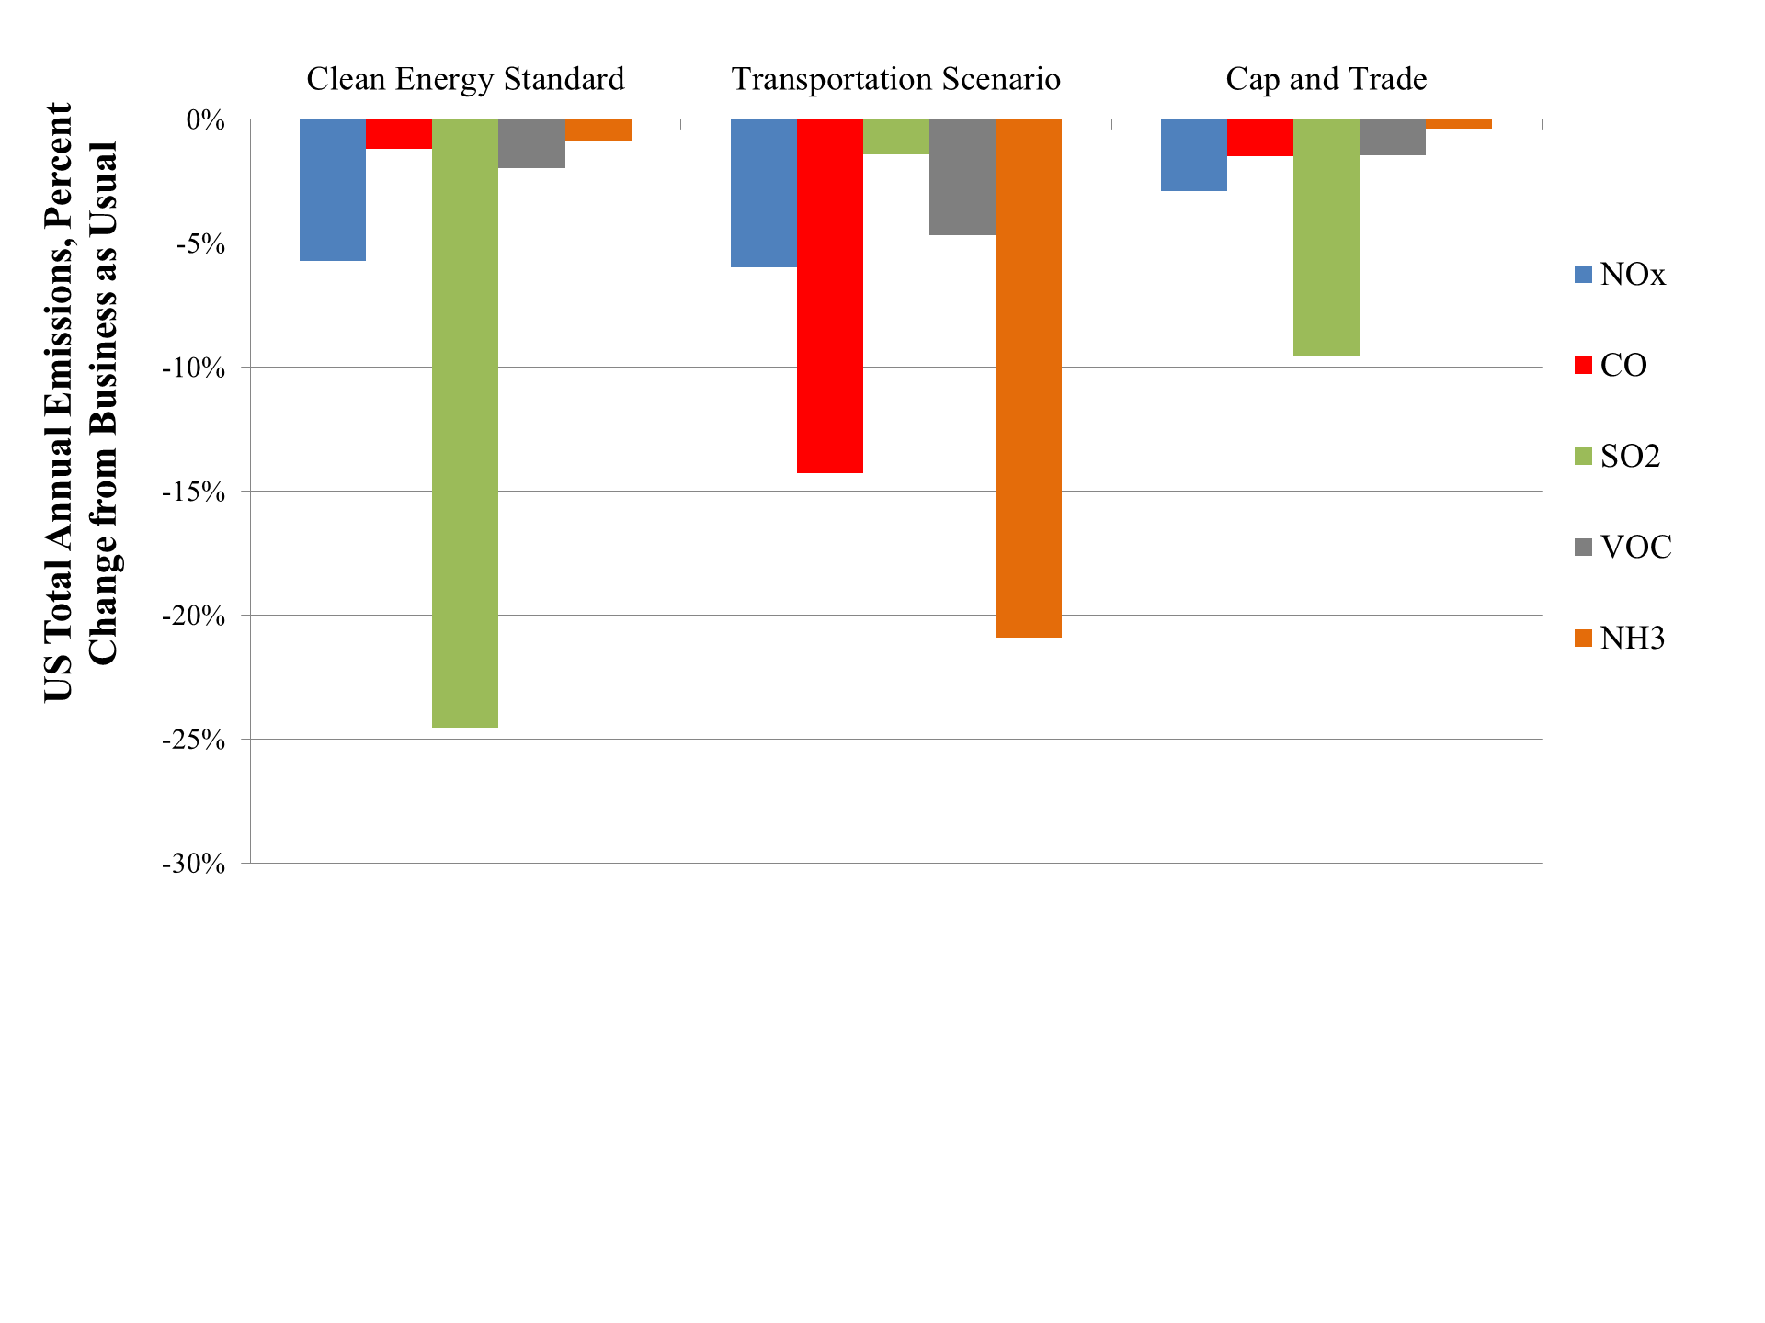
NOx
CO
Agriculture
(economic impact)
SO₂
Cars & trucks
NH₃
Power Plants
Carbon policies reduce different pollutants

Slide 14
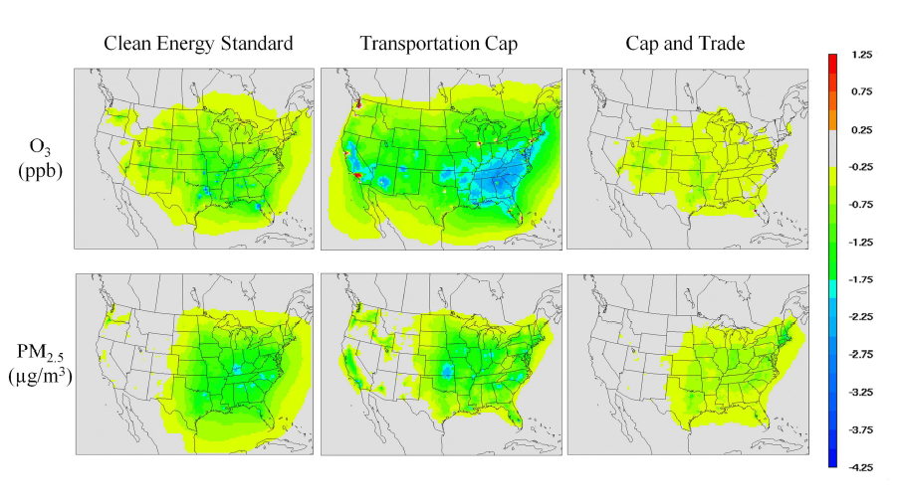
Widespread decreases in O₃ and PM_{2.5}
1
0
-1
-2
-3
-4

Slide 15
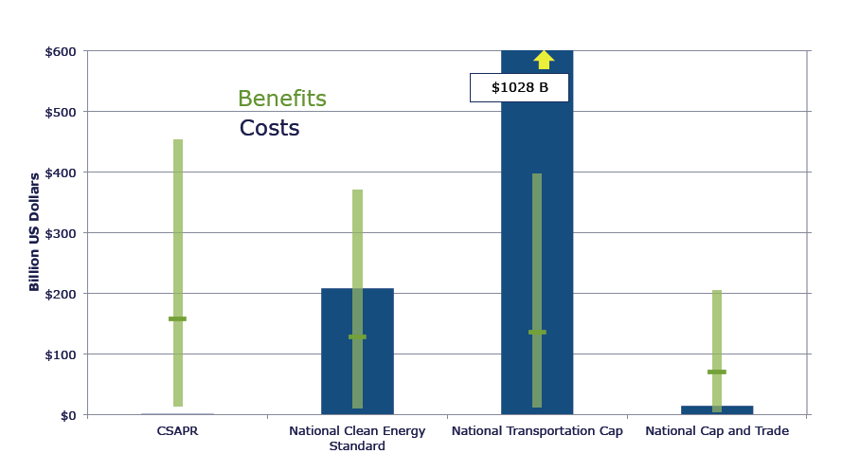
Results suggest “win-win” opportunities

Slide 16
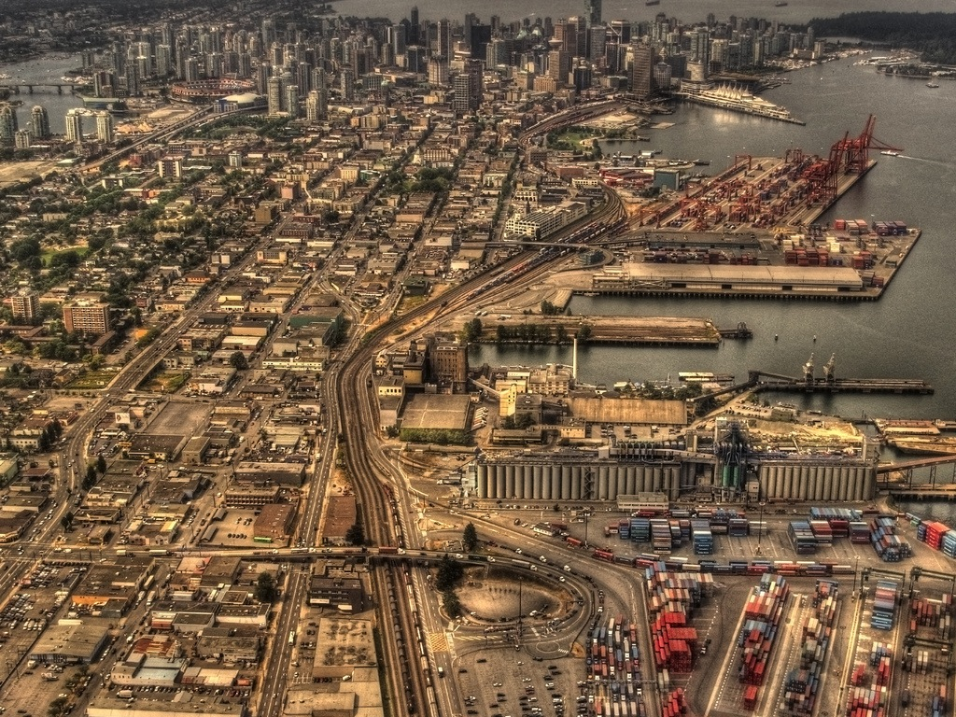
Cap and trade has large net (co-) benefits
Flickr/ecstaticist cc

Slide 17
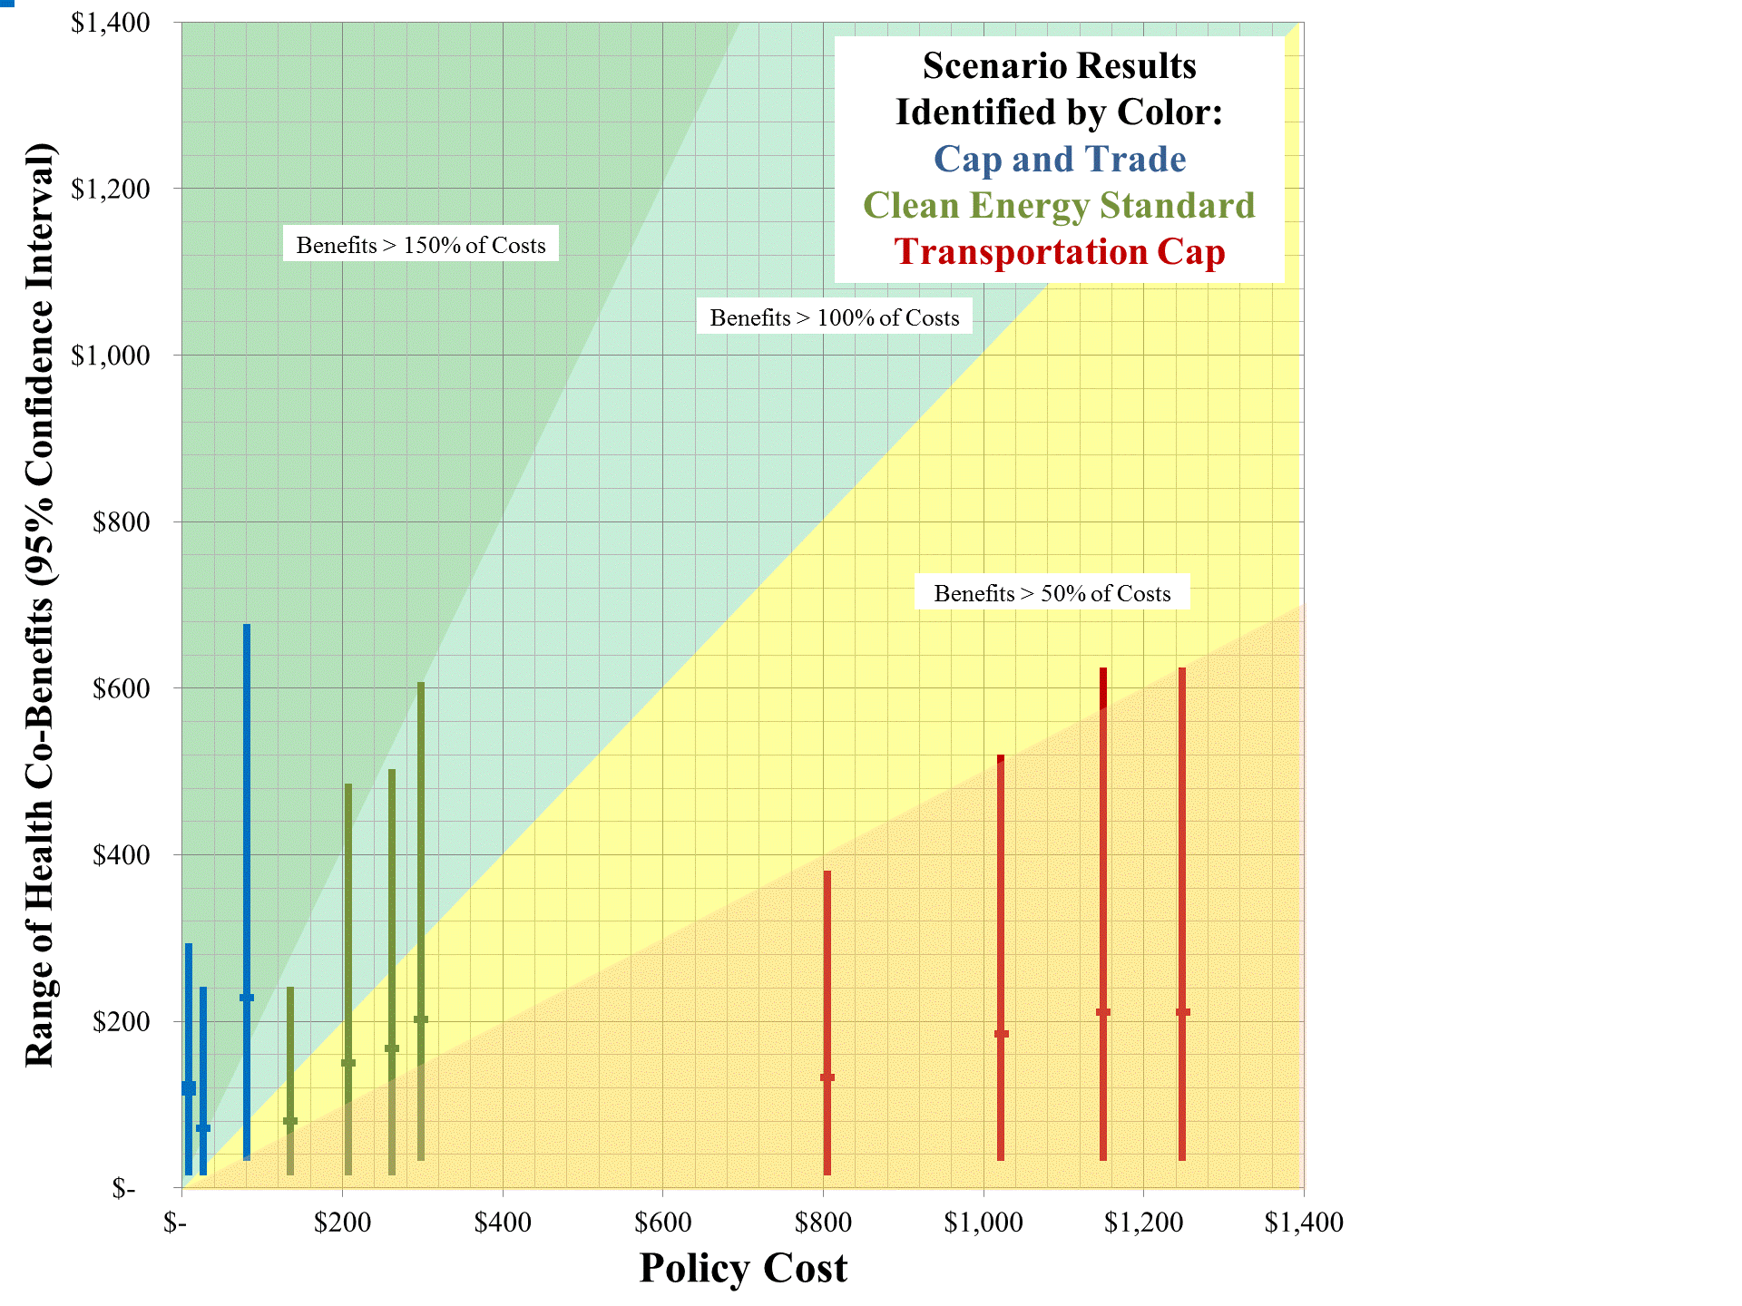
Each line:
Different economic assumption
>150%
>100%
>50%
Vertical extent: 95% CI for benefits

Slide 18
Cap and trade co-benefits are most variable
Flickr/ecstaticist cc

Slide 19
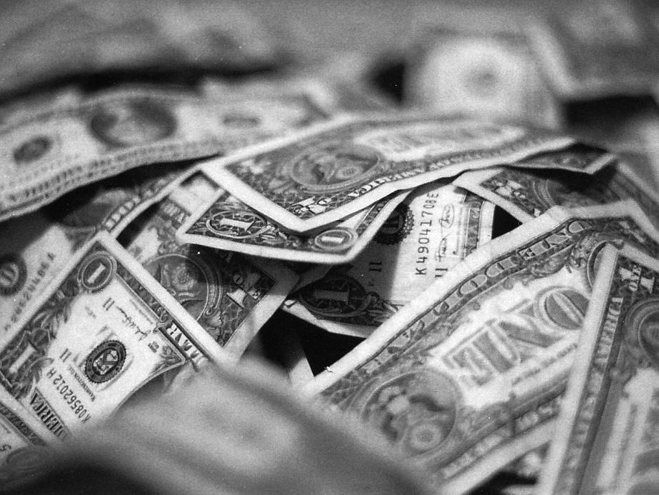
Benefits vary less than costs.
Economic assumptions determine net benefits
flickr/velo_city cc

Slide 20
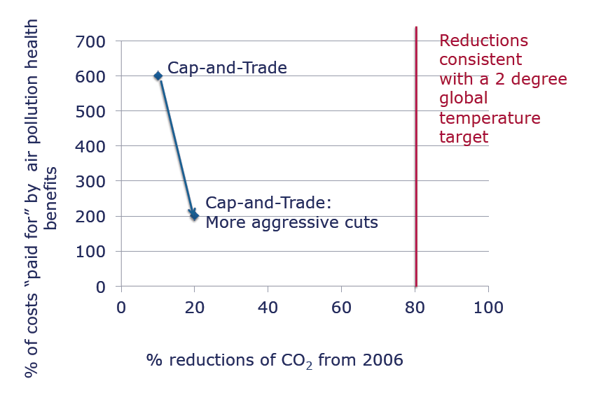
“Win-win” now: What about the future?

Slide 21

US benefits from global mercury treaty
A. Giang and N.E. Selin, in prep; A. Giang, MIT Technology and Policy Program Master’s Thesis, 2013

Slide 22
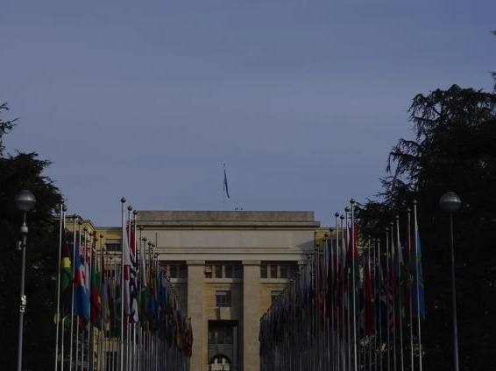
Newest global environmental treaty

Slide 23
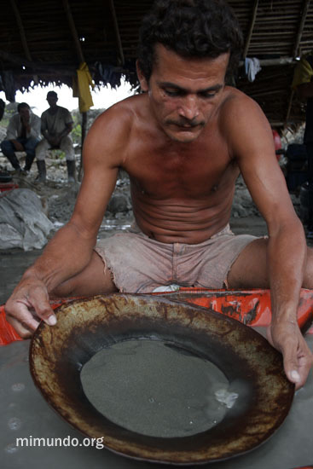
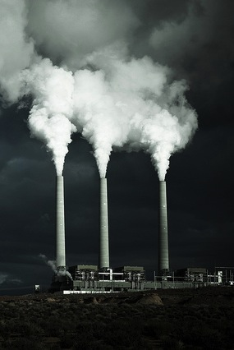
Largest mercury sources
Flickr/onesevenone cc

Slide 24
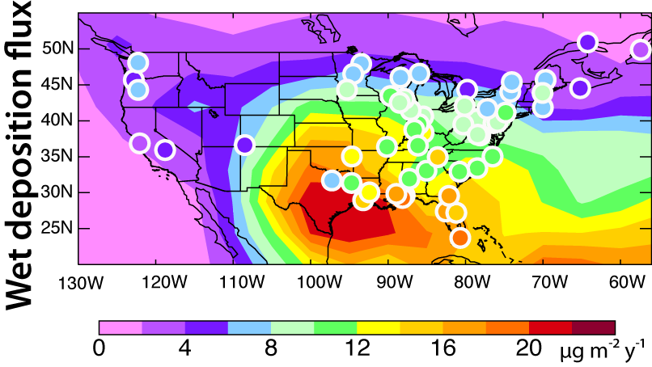
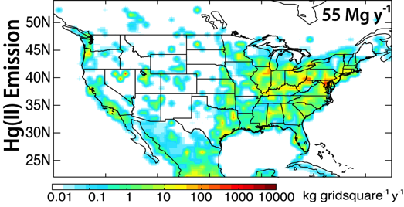
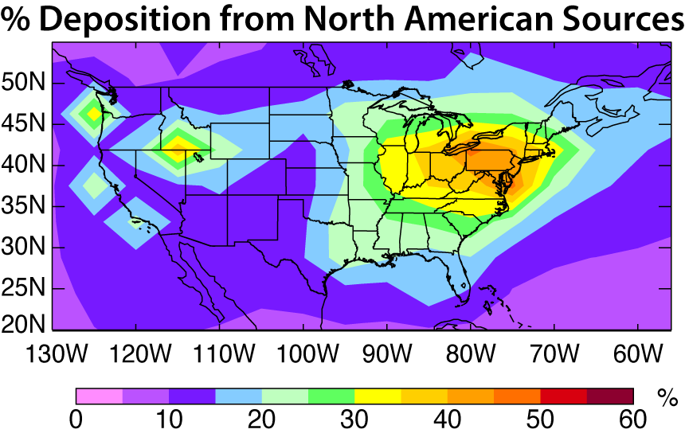
Mercury is a global and local problem
[Selin & Jacob, Atmos. Env. 2008]

Slide 25
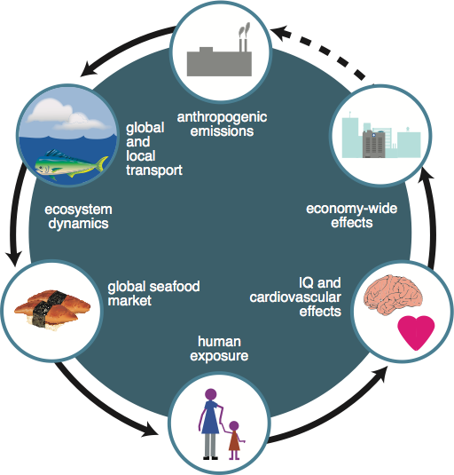
Tracking emissions to impacts for Hg

Slide 26
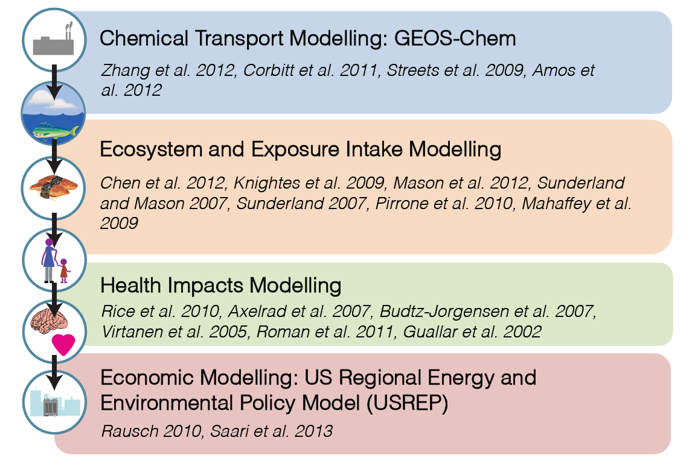
Integrated assessment for Hg

Slide 27
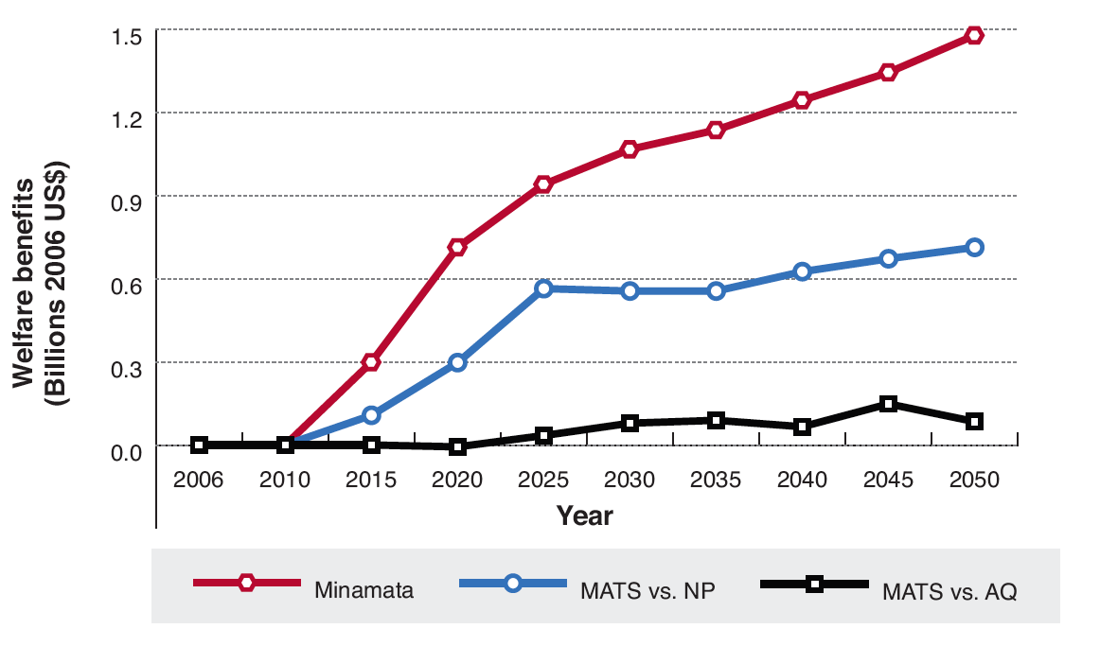
US gains $38 billion from Minamata
discounted at 3%

Slide 28
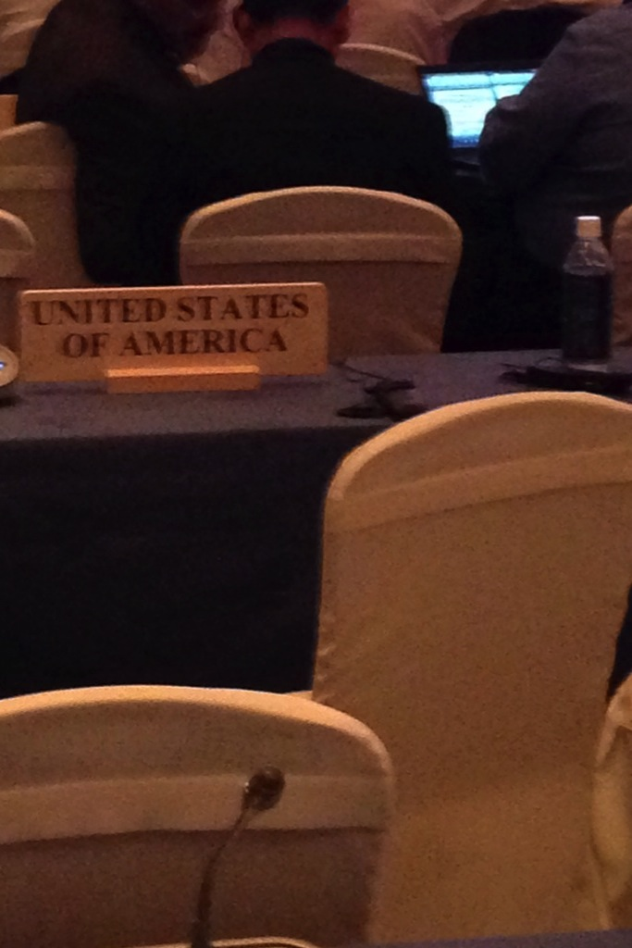
US will see substantial benefits from Minamata treaty

Slide 29
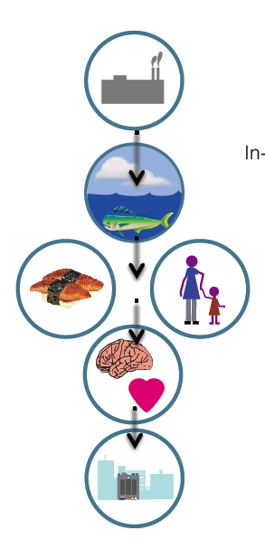
How can we assess contributions to overall uncertainty?

Slide 30
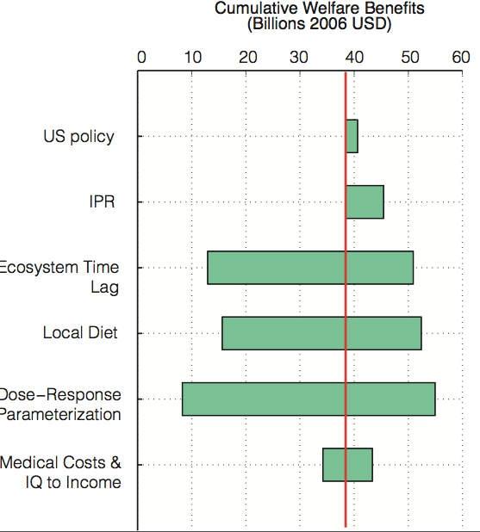
Policies-to-impacts sensitivity analysis shows largest
policy-relevant uncertainties
Chemistry
Ecosystem
timescales
Dietary choice
Dose-response

Slide 31

Dietary choices can be as important as other uncertainties

Slide 32
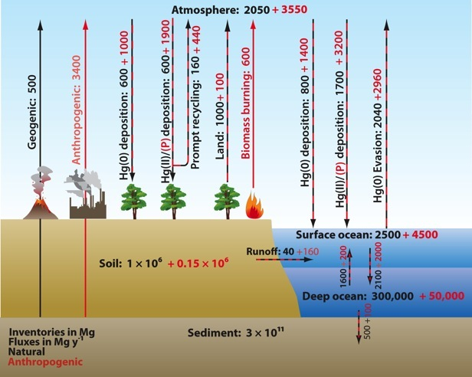
Benefit depends on timescales
Selin, Ann. Rev. Env. Res., 2009

Slide 33
What will happen globally?
+75%
0%
Present
+25%
Policy (2050)
+8%
+85%
+4%
No policy (2050)
+116%
+100%
+53%
+18%
+5%
+36%
+25%
+12%
+150%
-12%
Selin, Env. Tox. & Chem., 2013
Notes:
I used a six-box model, based on the timescales of the full GEOS-Chem chemical transport model mercury simulation. Spun up from pre-industrial times using two different estimates of historical emissions. I applied trajectories to 2050 fpr this policy and a most optimistic policy case and look at changes. What might we expect to see? Order-of-magnitude estimate. And then compare these changes to what we’re able to observe/attribute.
First, the policy case. I used a scenario here with a 12% emissions decrease, which represents very aggressive implementation of mercury-specific technology. We see no change in atmospheric mercury, and increases in many of the compartments. This is because of the timescale of the problem – historical mercury still affects the system.
Under the no-policy case, there are larger changes – up to 75% in the atmosphere to 2050. But I’ll remind you that our best quantitative estimate of uncertainties from these fluxes are 65%. And in terns of trends in the atmosphere, attributing 1-2% changes is still difficult (same change as here). So, that’s what we’re looking at. And it’s the difference between the policy and no policy case that is the greatest benefit, which means that to identify benefits, you need to estimate and attribute what would have happened without policy, which requires not only modeling, but also analysis of the root causes of emsisions changes (so collaboraiton with social sciences as well as policy-makers and engineers)

Slide 34
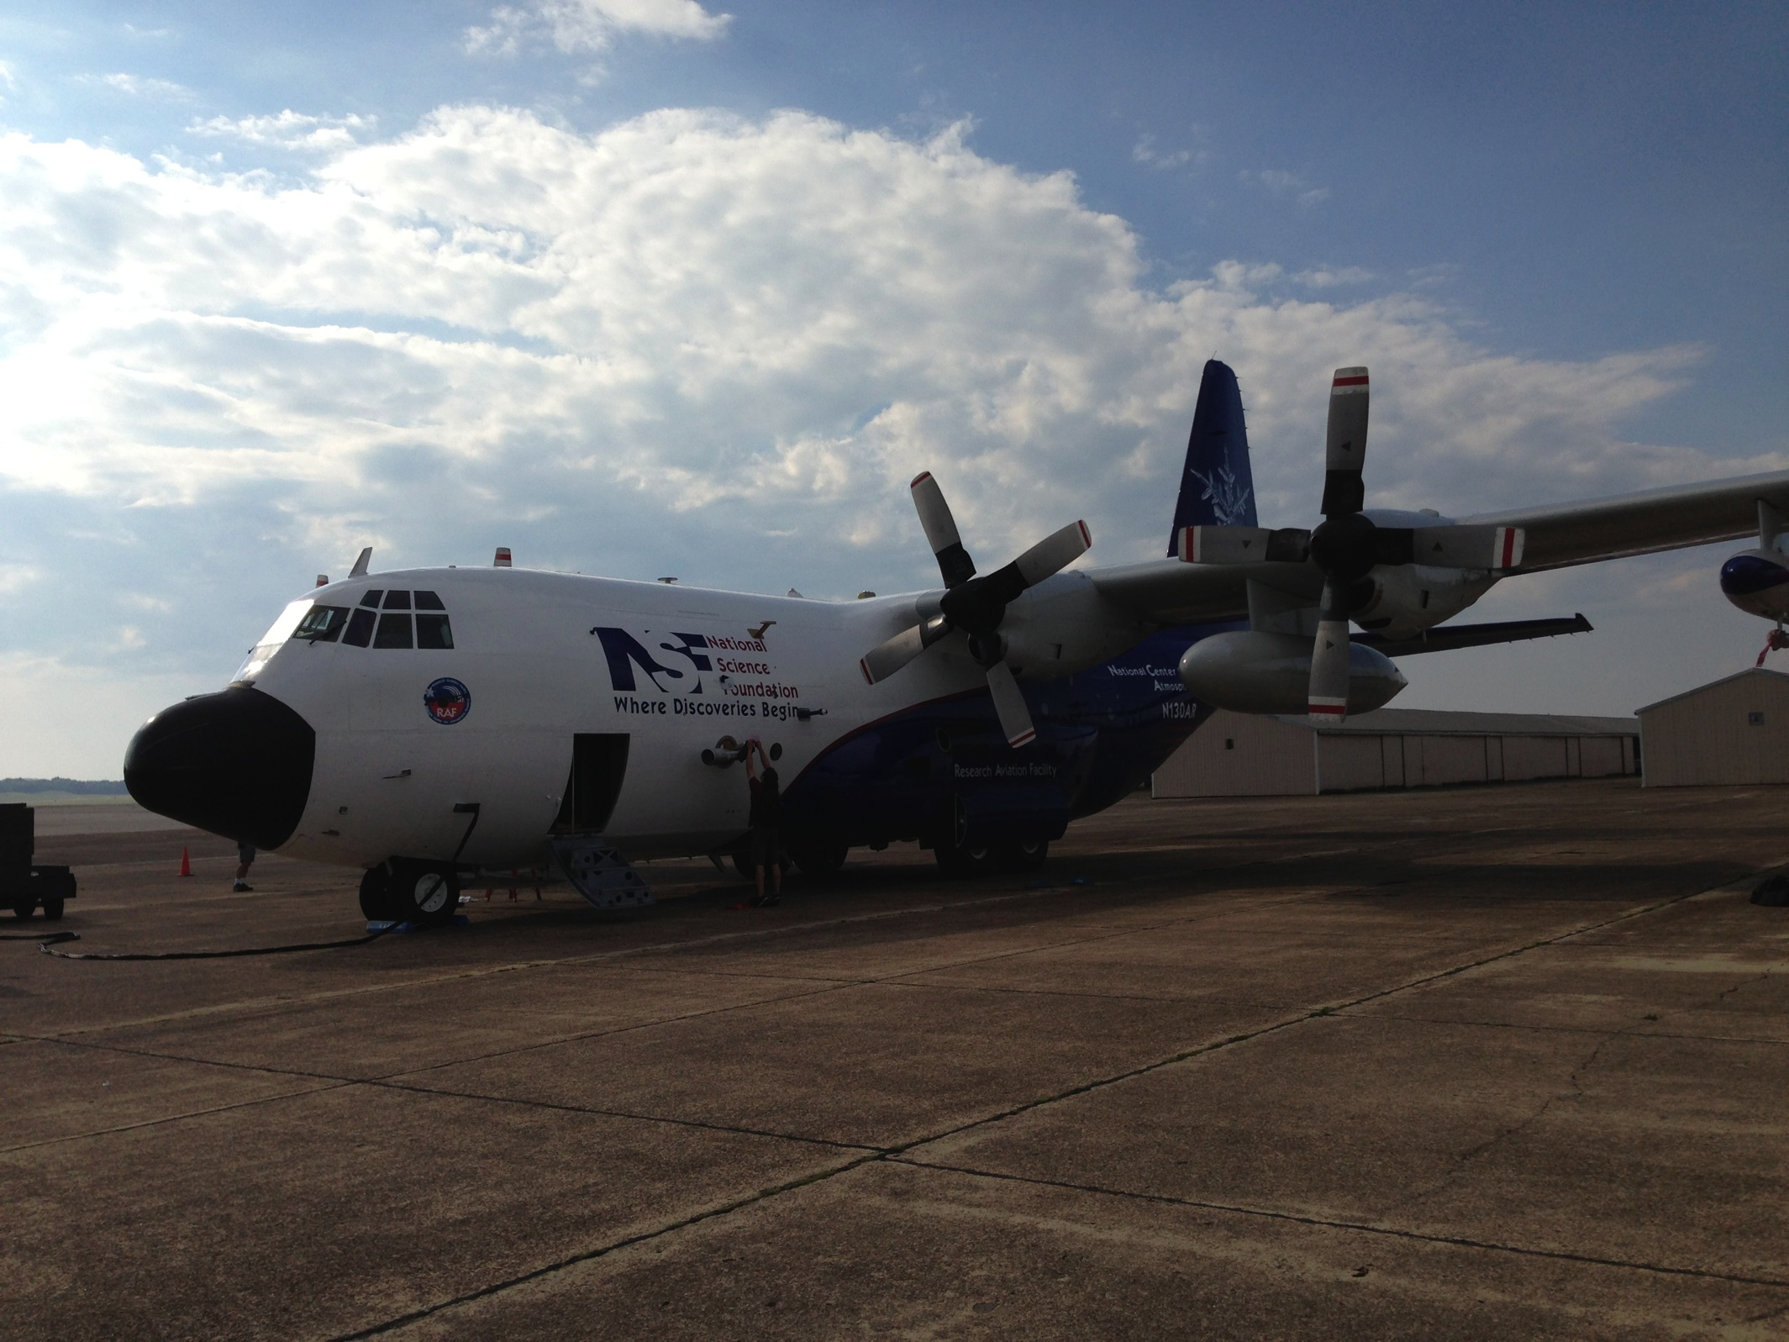
More data coming soon

Slide 35
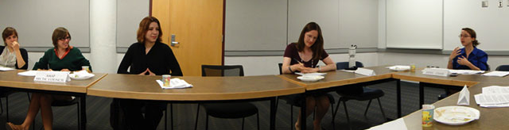
To learn more, play the Hg game
http://mit.edu/mercurygame

Slide 36
http://mit.edu/selingroup
Postdocs:
  Carey Friedman (PhD, URI)
  Fernando Garcia Menendez (PhD, Georgia Tech)
Graduate Students:
  Rebecca Saari, Engineering Systems 4th yr: Air pollution health impacts
  Ellen Czaika, Engineering Systems 4th yr: Sustainability decision-making
  Shaojie Song, Earth, Atmospheric & Planetary Sciences, 3rd yr: Mercury
  Colin Pike-Thackray, Earth, Atmospheric & Planetary Sciences, 3rd yr : POPs
  Amanda Giang, Engineering Systems, MS TPP and 1st yr PhD: Mercury
  Mingwei Li, Earth, Atmospheric & Planetary Sciences, 1st yr: Pollution transport
  Leah Stokes, Urban Studies/Planning DUSP 4th yr: Mercury science-policy (primary advisor: Larry Susskind)
  Jareth Holt, EAPS 4th yr: Air pollution uncertainties (co-advised with Susan Solomon)
  Corey Tucker, Technology and Policy Program, 1st yr: Mercury
Recent alumni:
  Tammy Thompson (PhD, U. Texas): Regional-to-global atmospheric chemistry modeling, now at CIRA/Colorado State University as Research Scientist
Funding:
  NSF: Atmospheric Chemistry Program CAREER grant; NSF Office of Polar Programs; NSF Coupled Natural and Human Systems Program; MIT Research Support Committee Ferry fund; MIT Research Support Committee Wade Fund; U.S. EPA: Science to Achieve Results (STAR) Program; Leading Technology and Policy Initiative at MIT

