Slide 1
Using experience and market curves to inform energy technology subsidy policy
Eric Williams, Schuyler Matteson
Rochester Institute of Technology
Seth Herron
Arizona State University

Slide 2
The Golisano Institute of Sustainability
Academic Programs:
  Ph.D. in Sustainability
  M.S. in Sustainable Systems
  M. Sustainable Architecture
Core Courses for PhD and M.S.:
  Fundamentals of Sustainability Science
  Industrial Ecology
  Risk Analysis
  Economics of Sustainability
  Multicriteria Sustainable Systems Analysis
  Technology, Policy and Sustainability
New building:
LEED platinum (in process)
Fuel cell, PV, wind, ground source heat pump, green roof, sensors ….

Slide 3
Working hypothesis
Cheap renewable & ultra-efficient energy technologies would do great things for sustainability

Slide 4

Government interventions to make energy technologies cheaper
Investment in Research and Development, e.g. Dept. of Energy
Adoption/efficiency targets – e.g. biofuel, CaFÉ standards
Economic subsidies – e.g. federal, state, and utility support for solar, wind fuel cells, electric vehicles, etc.

Slide 5
State of knowledge of future economic performance of energy technologies
Current state?
Zero future knowledge
Perfect forecasting: invest $X.XXX to get technology with price $Y.YYY
Current state?
Zero use: roll dice
Extensive and iterated analysis w/ uncertainty
Use of knowledge in policy-making

Slide 6
Forecasting technological progress
Retrospective forecasting – e.g. experience curves
Expert elicitation
Scenario analysis

Slide 7
Experience Curve
C(P) = C₀ (P/P₀)^{-α}
C = cost of production per energy unit (e.g., $/Wp or $/kWh)
P= cumulative production (e.g. total watt capacity of solar cells produced)
α is empirical constant
Learning rate given by α = - log₂(1-LR)
LR= % cost reduction each doubling of production
Sources: PV module prices from Margolis (2002) and EIA (2008). Module installations from Margolis, NREL (2006) and Solarbuzz (2008, 2009)
Notes:
U.S. PV module market from 1976 to 2007
Several studies suggest that PV modules are part of a global learning (Schaeffer, Alsema, et al. 2004; Shum & Watanabe, 2008).
As Schaeffer, Alsema, et al. (2004) suggest, if local volume is assumed but the local volume growth rate is not identical to the global volume growth rate, technological learning models will generate erroneous results.

Slide 8
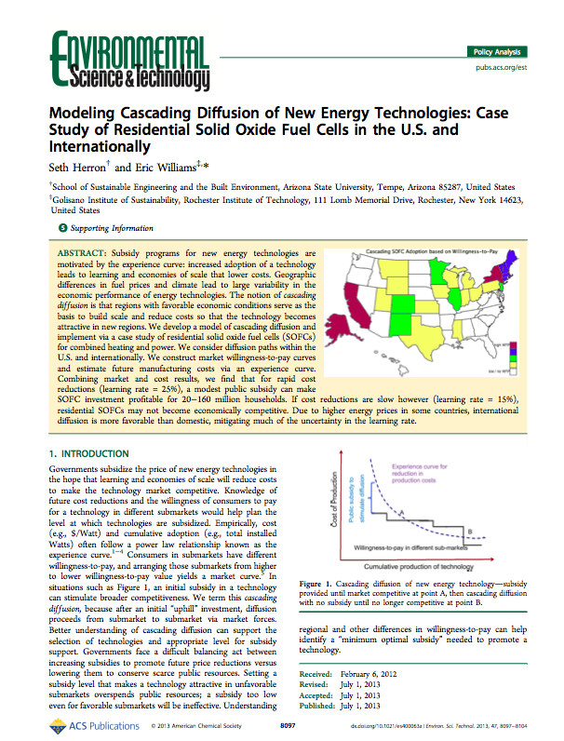
Research goal – use experience curves to inform energy subsidy policy
Question 1: How does differing willingness to pay in sub-markets for technology affect appropriate subsidy?
Question 2: How do national vs. international diffusion differ?
Question 3: How does tapering frequency of subsidy affect public investment?
Preliminary results

Slide 9
Question 1: Cascading diffusion of energy technology
Experience curve for reduction in production costs
Public subsidy to
stimulate diffusion
Cost of Production
A
B
Willingness to pay in different sub-markets
Cumulative production of technology

Slide 10
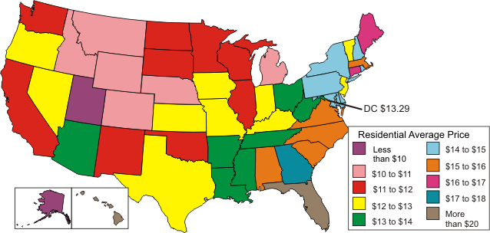
Geographic variability in natural gas prices
$ per Thousand Cubic Feet
Source: Energy Information Admin

Slide 11
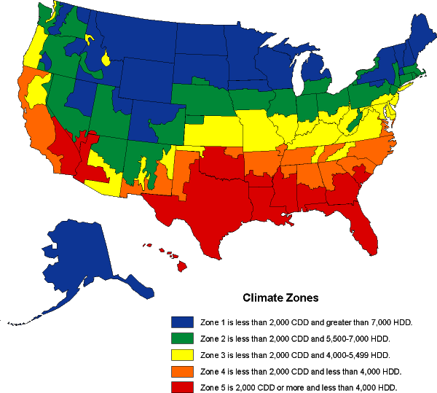
U.S. Climate Zones
Source: Energy Information Admin

Slide 12
Question 2: National versus international diffusion
Globalized production/trade implies cost reductions achieved in country A apply (to a large degree) to country B.
Given that energy prices are higher in some countries, international diffusion paths could be much more favorable than national ones.

Slide 13
Building a model
Willingness to pay in sub-markets: construct based on geographic variability in climate and energy prices.
Experience curve: base on retrospective market data, with optimistic and pessimistic cases.
Uncertainty: Future costs and willingness to pay are uncertain forecasts. Treat critical parameters as ranges.

Slide 14
Case study: micro-Solid Oxide Fuel Cells (SOFC) for residences
Combined Heating and Power (CHP) uses heat normally wasted
SOFC are promising CHP: scalable, efficient (40-50% to electricity, zero water demand, quiet, low emissions) and technology improving rapidly
Currently expensive, ~$20-30/W for residential system
Construct U.S. (50 states) and international diffusion paths.

Slide 15
System analyzed
Fuel cell is sized at 1 kW, providing full electricity demand for most hours of the day, but not peak. Electricity efficiency = 45%, Heat efficiency = 45%
Electricity from the grid is imported as needed.
Natural gas furnace supplements heat from SOFC as needed
Full-on mode: runs 24 hours a day, selling electricity to grid as needed
Used Equest energy modeling to determine energy/electricity flows using local climates

Slide 16
Willingness to Pay
Our definition of Willingness to Pay (WTP):
  WTP = Maximum $ Investment to get 5 year payback time with discount rate = 10%
Optimistic (pessimistic) gas and electricity prices: most (least) favorable year from 2005-2009
Treating only “direct economic” part of purchasing decision, i.e. no perceptions of risk, environmental benefits, etc

Slide 18
Experience curve
Cost = C_{incompressible} +
(C_{initital} – C_{incompressible )}(Cum. production)^{α}
Initial price and production data from Australian manufacturer, gave price range.
Lack of data on learning rate, found range based on similar technologies
Use scenario approach bounding curve – optimistic: C_{initital} = $20,000, LR = 25%
pessimistic: : C_{initital} = $37,000, LR = 15%
Incompressible cost = $800 (Braun 2010)

Slide 23
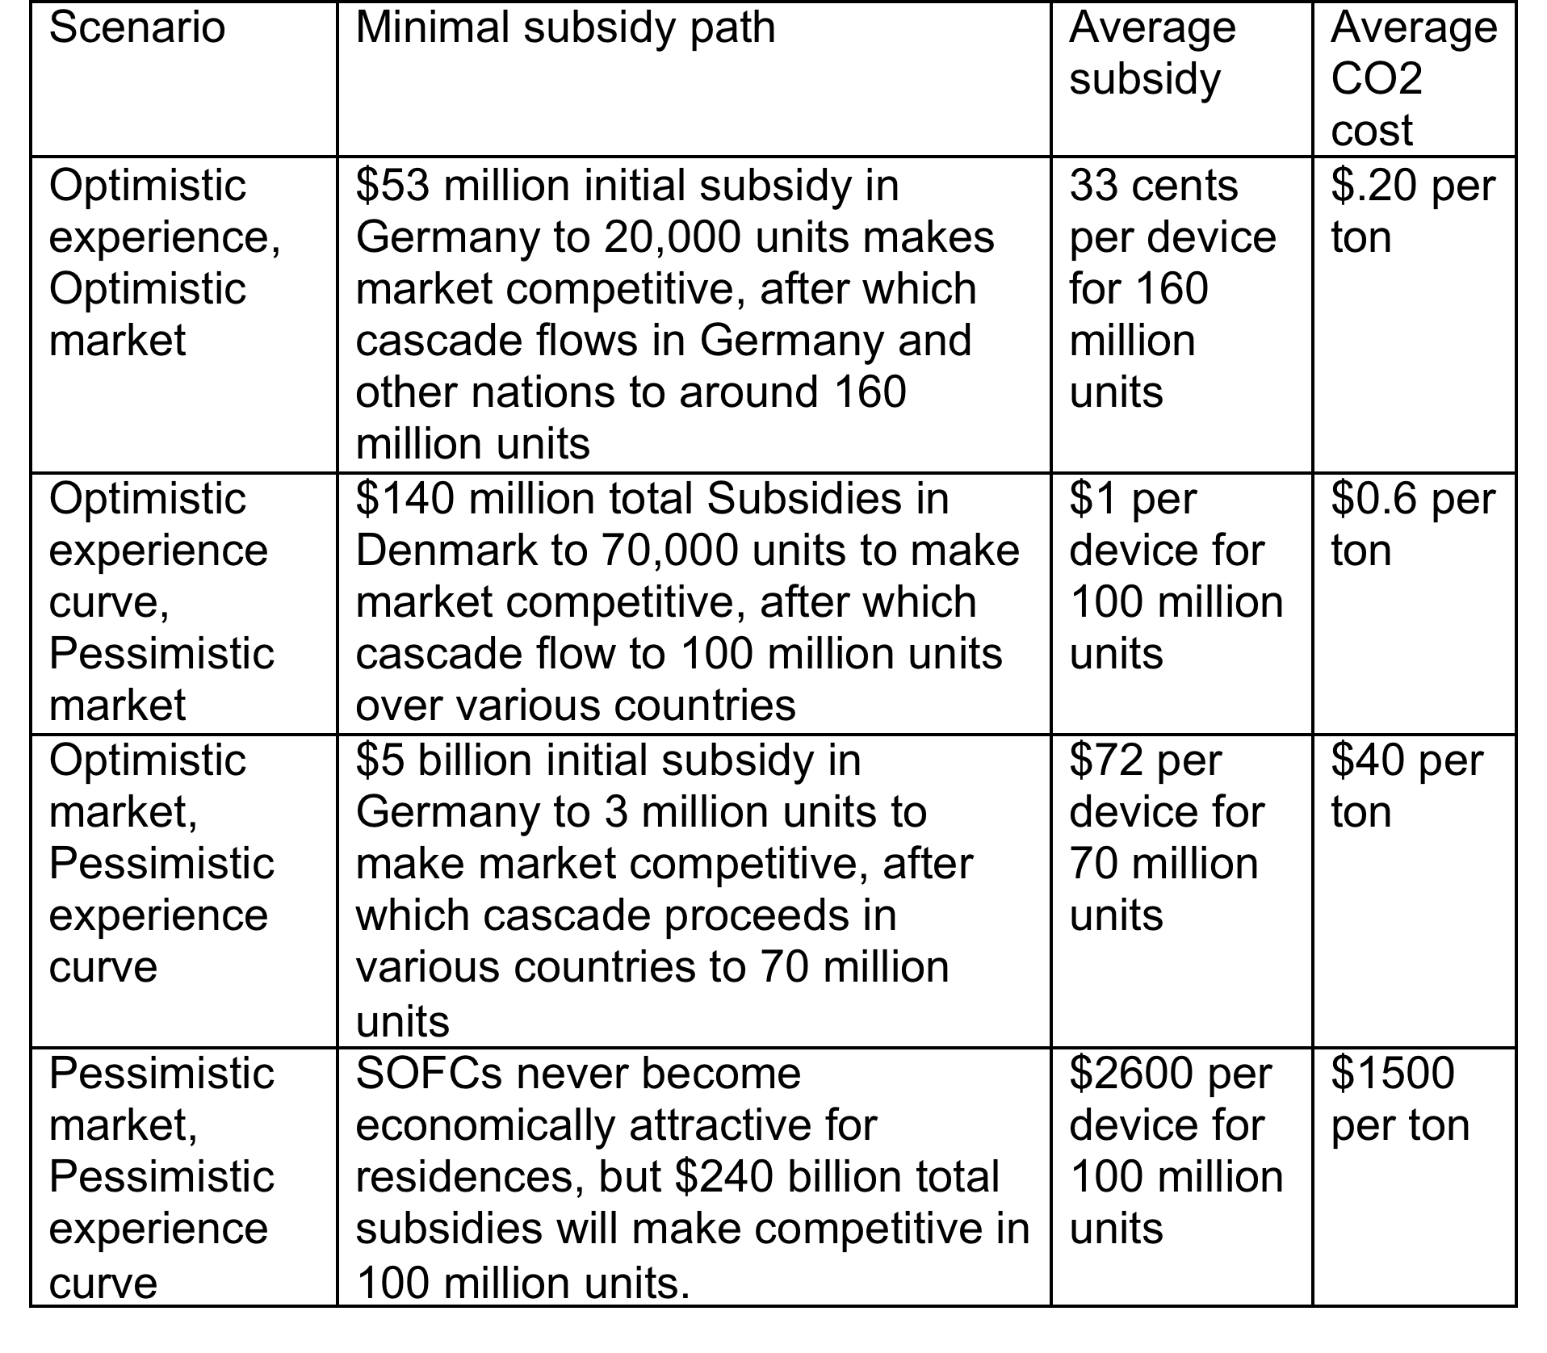
Results: International diffusion

Slide 24
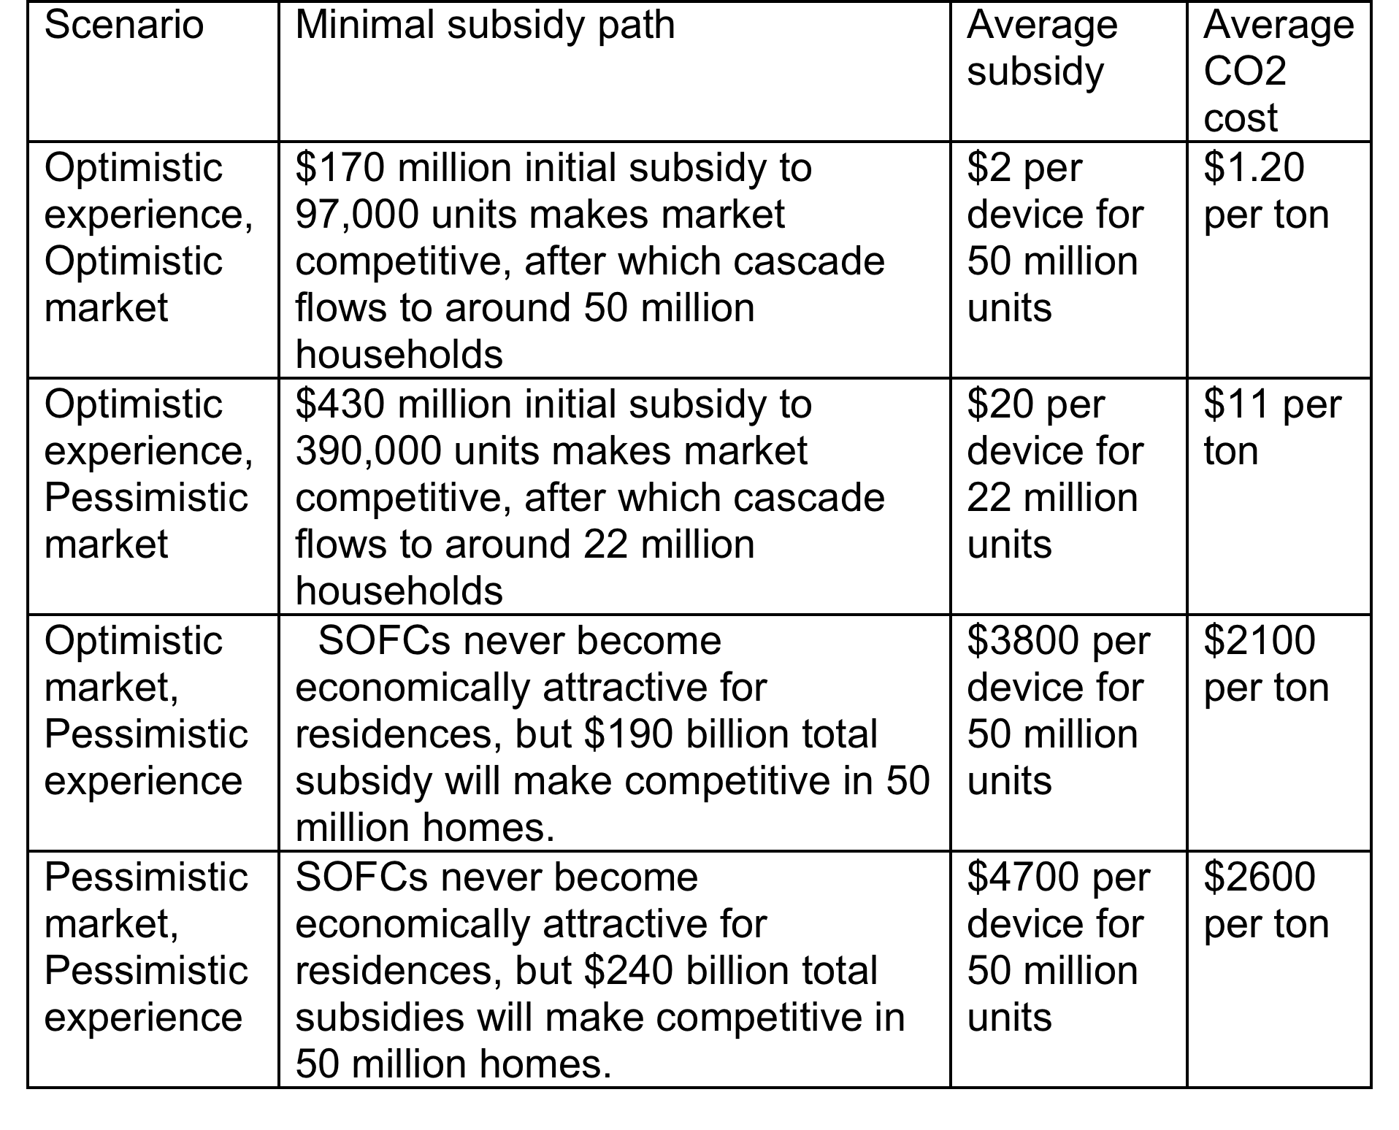
Results: U.S. diffusion

Slide 25
Discussion
Uncertainty in learning rate can flip SOFC from a prime candidate for subsidy to terrible one.
Two policy options:
  Serious study of technology scale-up
  Provisional subsidy, measure LR through experience
International cooperation on technology subsidies?

Slide 26

Thank you for your attention!
exwgis@rit.edu
This research was supported by the National Science Foundation, Environmental Sustainability Program
Letchworth State Park, near Rochester, New York

